Slide 1
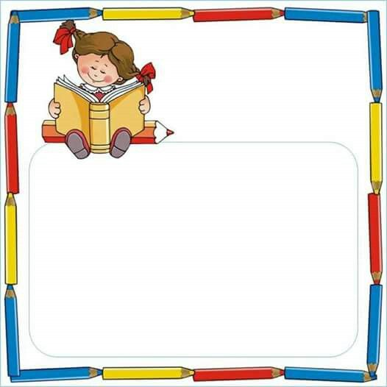
Public School 174 65-10 Dieterle Crescent Rego Park, NY 11374 Phone (718) 897-7006 ps174.org
Mrs. Karin Kelly, Principal Mrs. Kerstin Kobetitsch, A. P.
Moving into “Just-Right” Books
By Kindergarten Teachers
For Kindergarten Parents

Slide 2
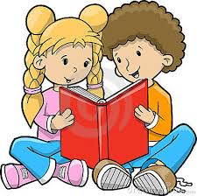
“Just-Right” Books
Also called:
Leveled Books
Children start looking at the print.

Slide 3
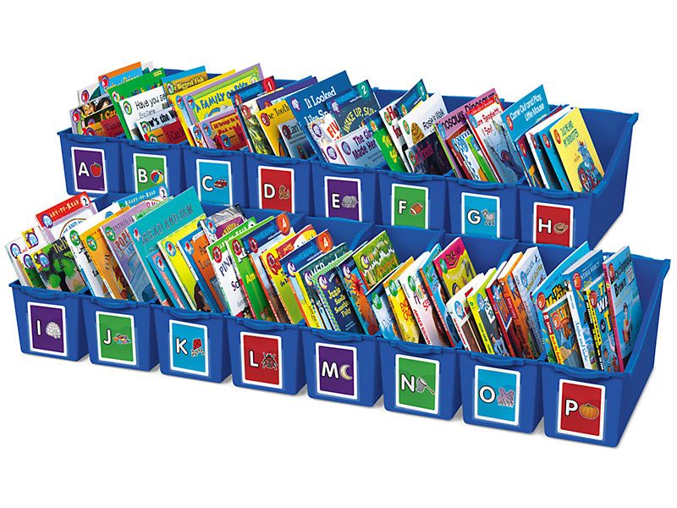
Which books are “JUST RIGHT” for you?

Slide 4
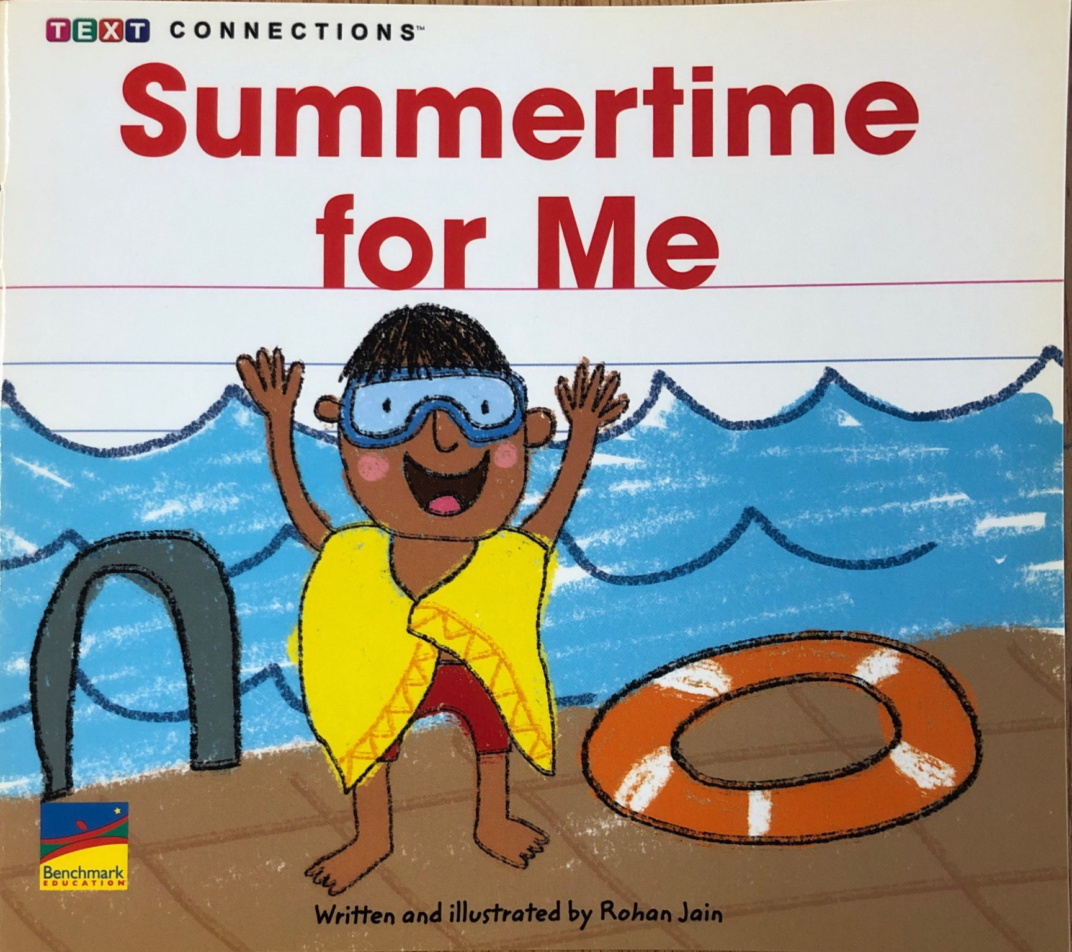
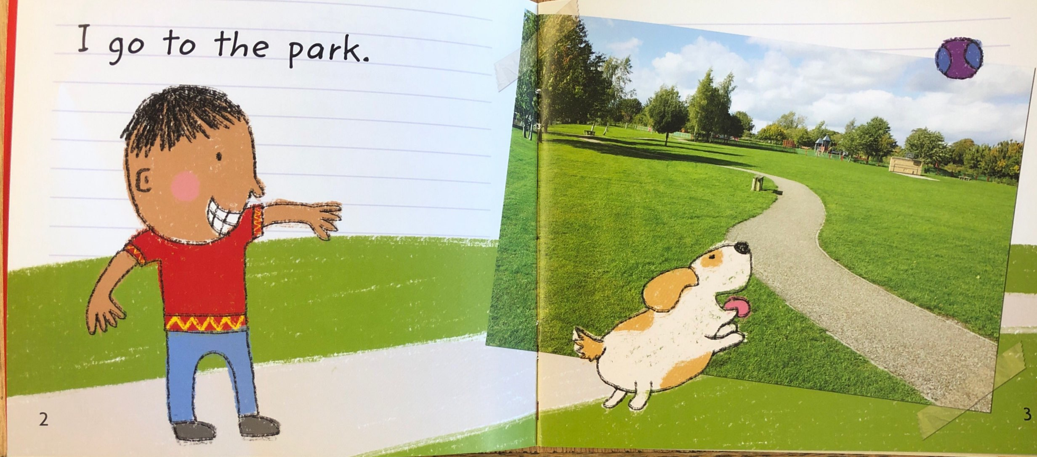
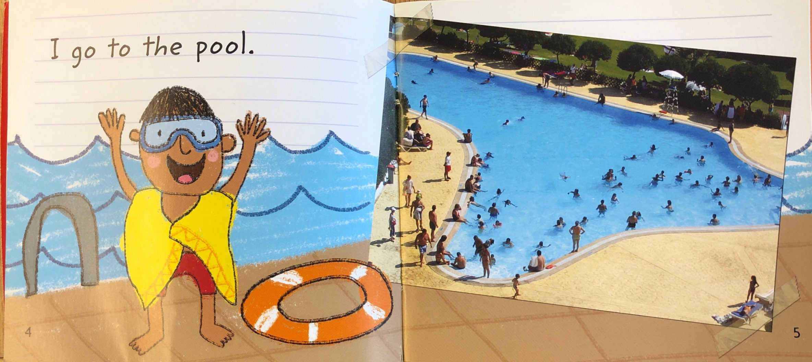
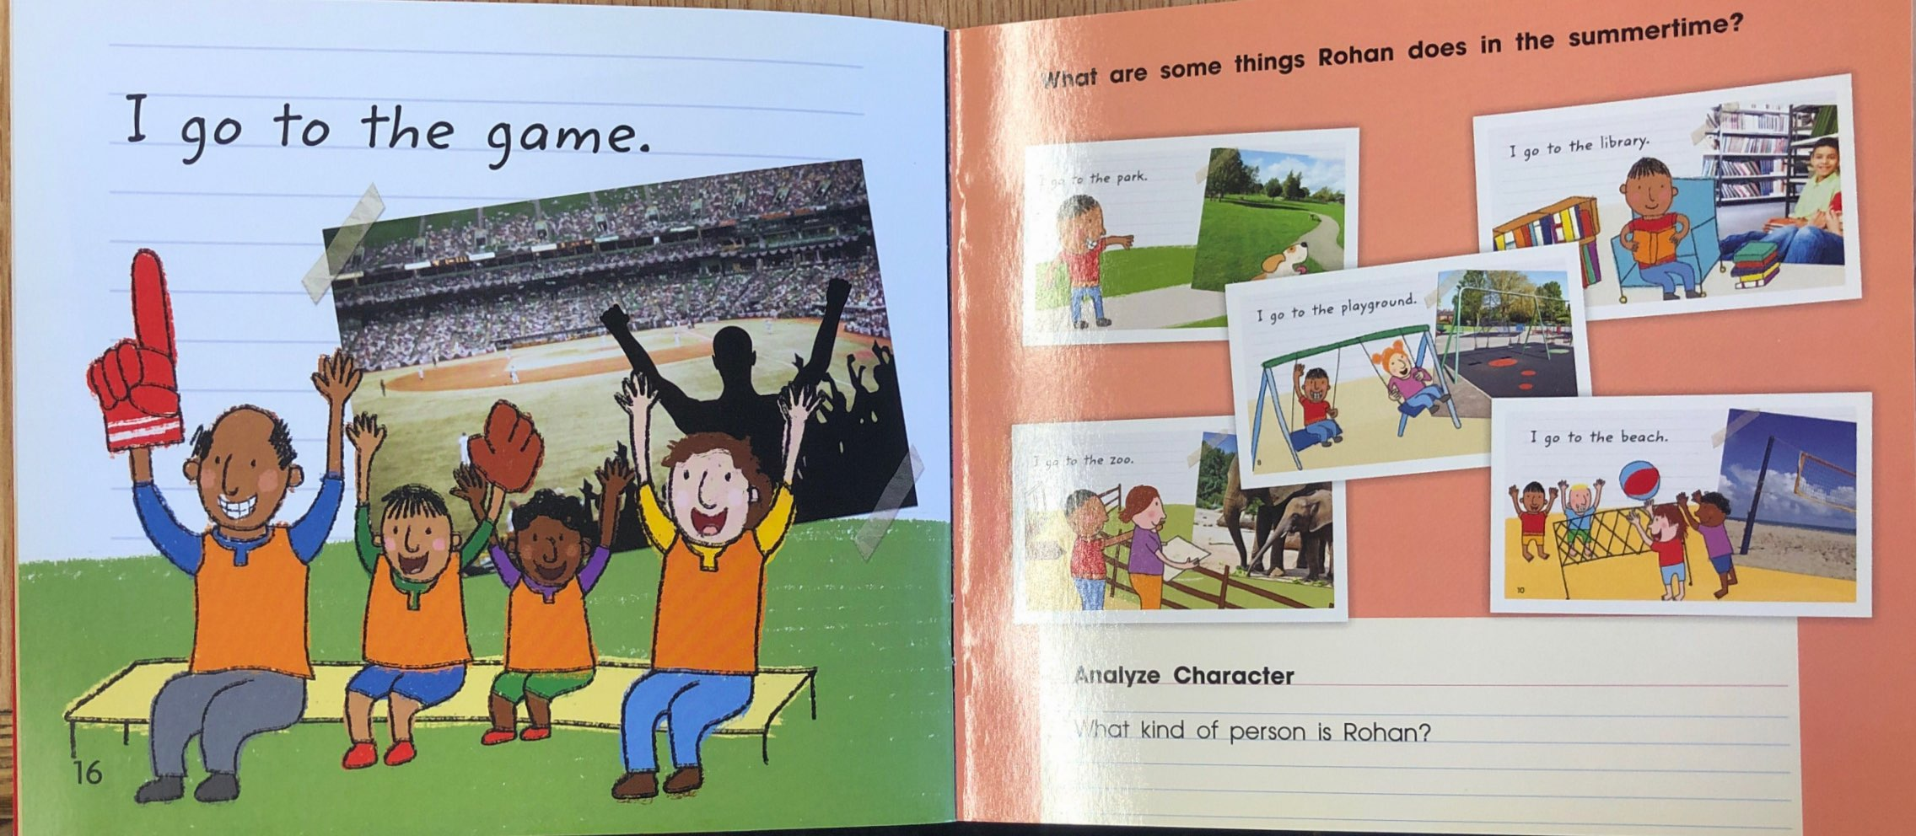
“A” books have a simple pattern on every page.
Example:
I go to the park.
I go to the pool.
I go to the game.

Slide 5
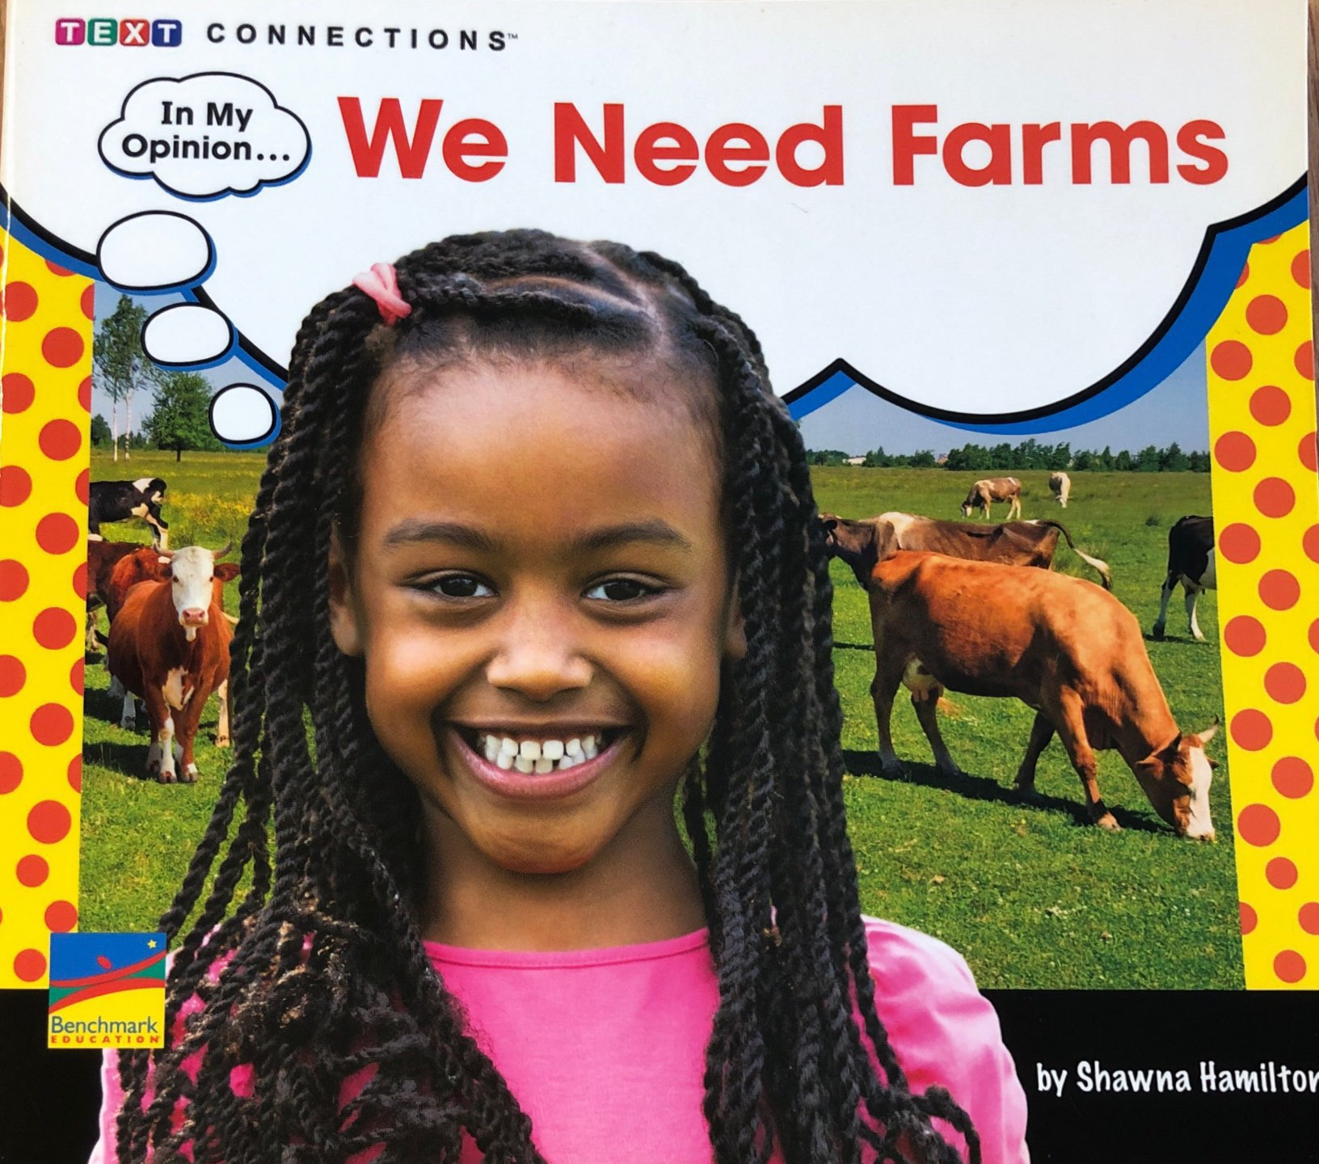
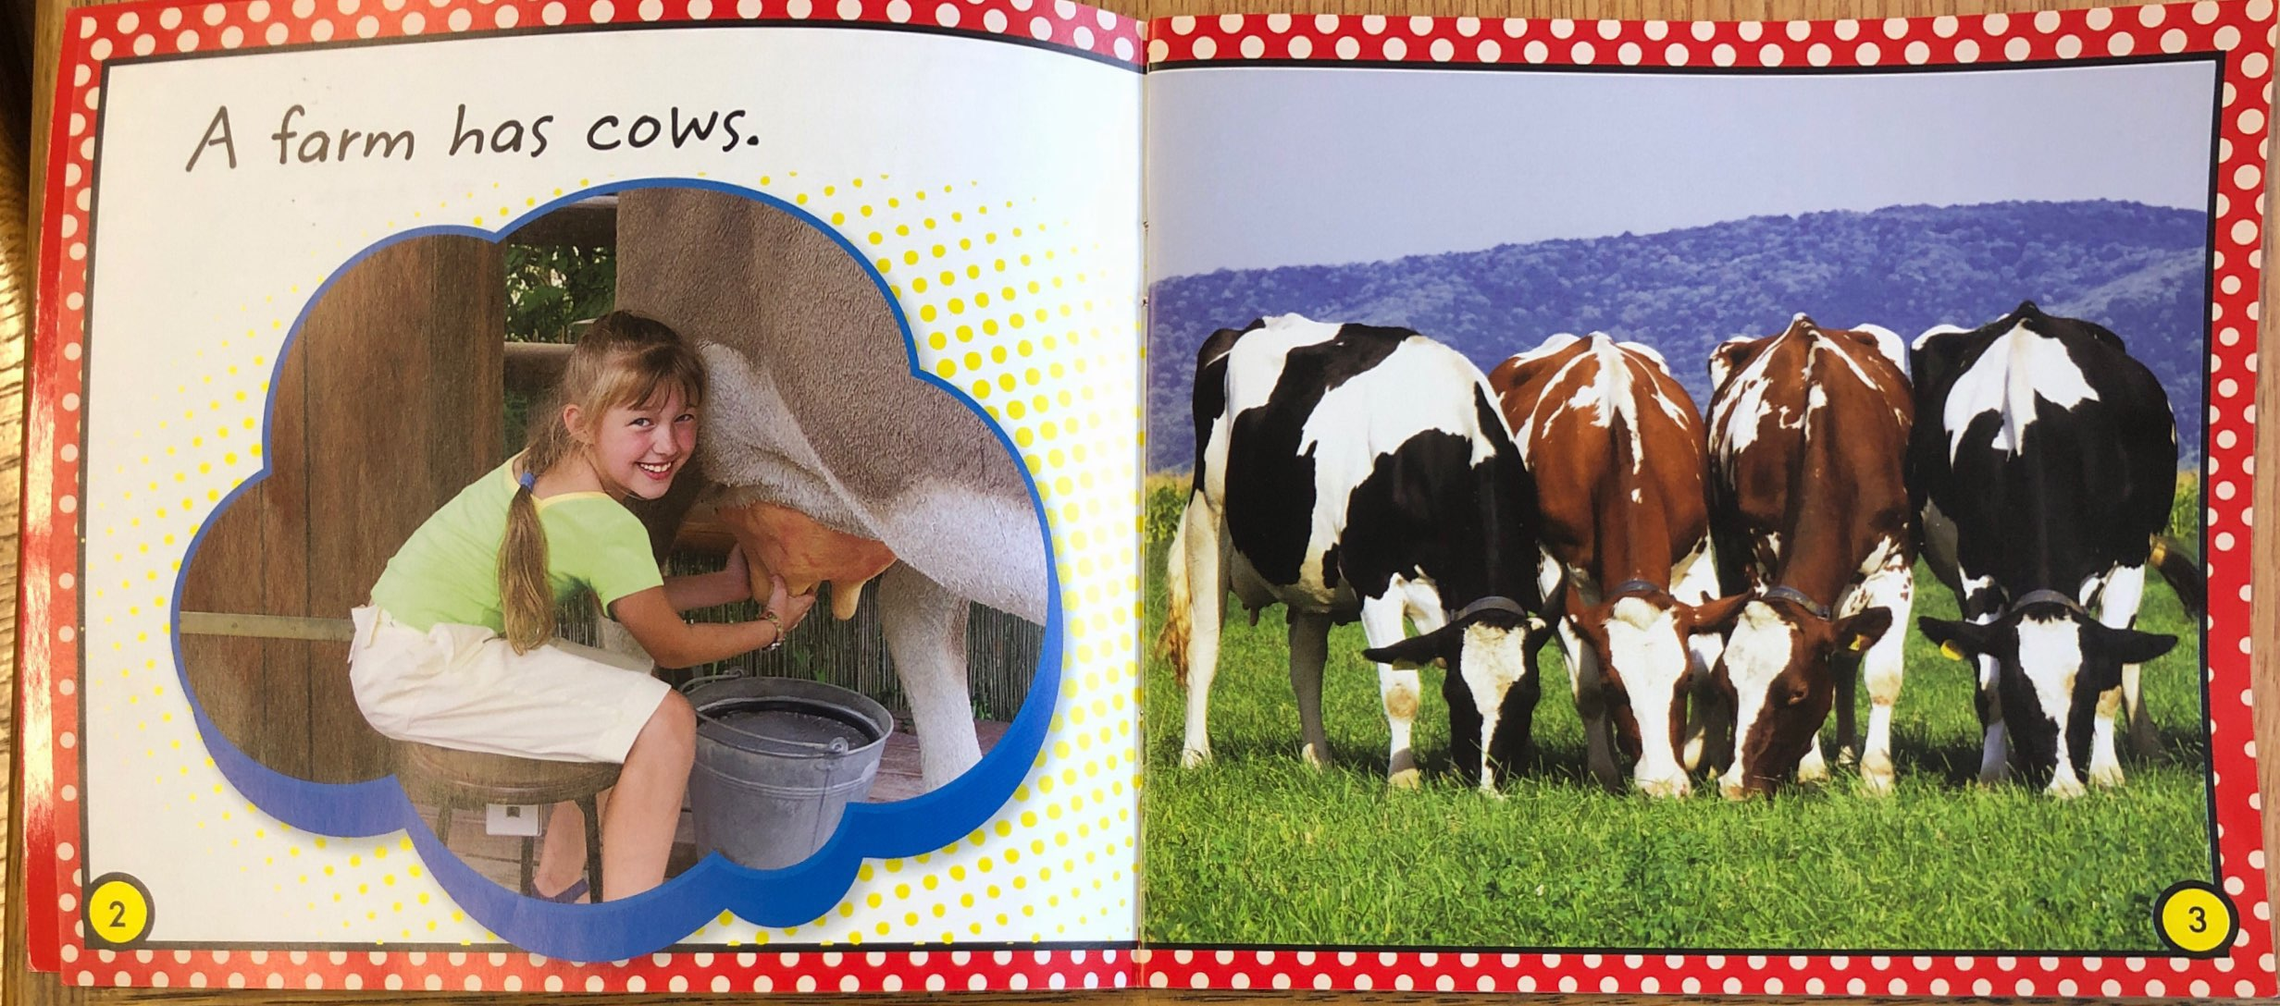
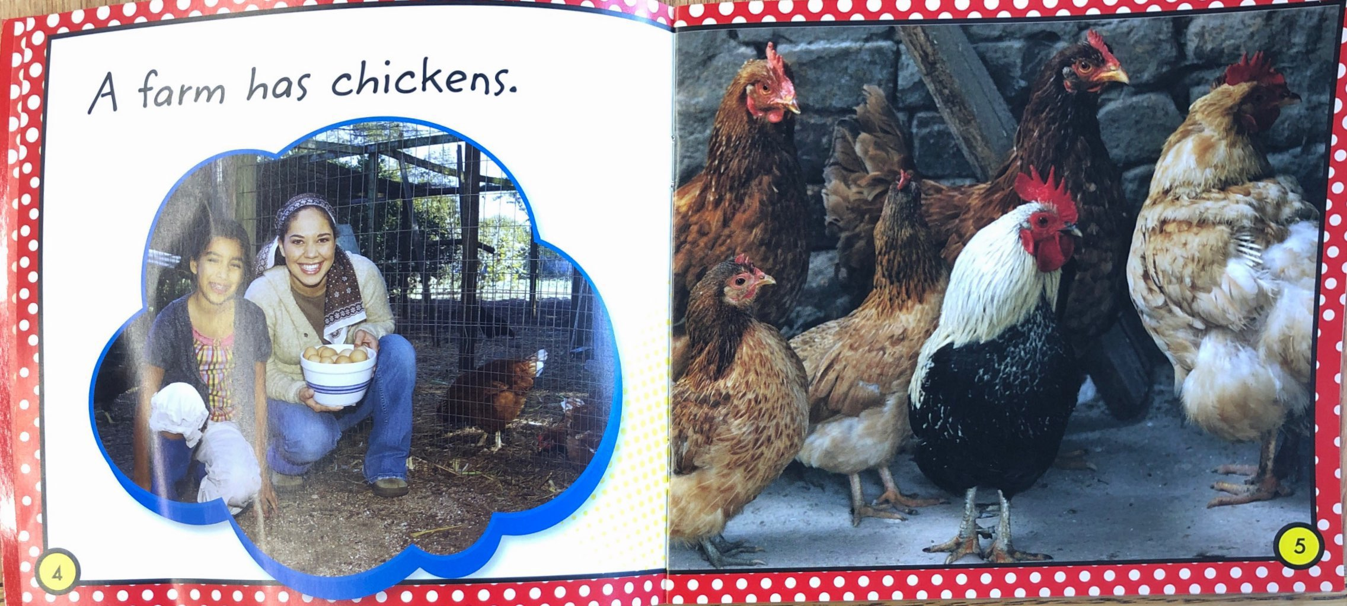
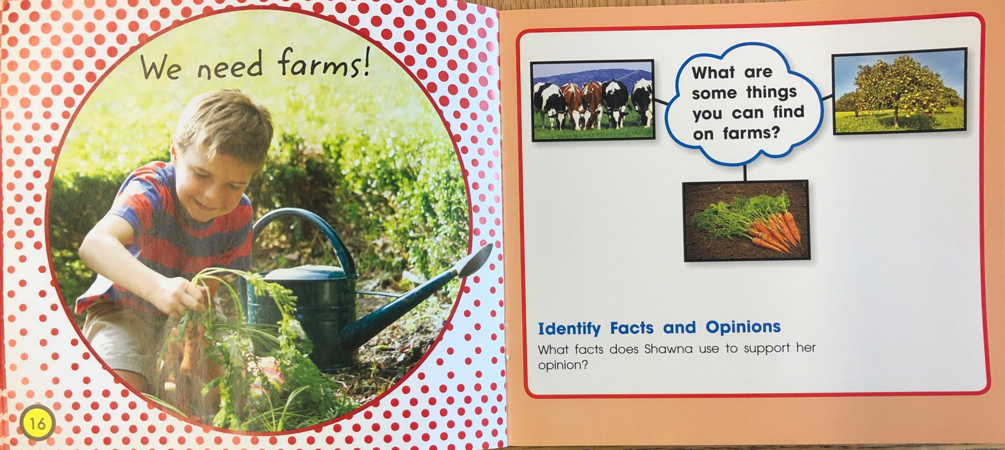
In “B” books, the pattern changes on the last page.
Example:
A farm has cows.
A farm has chickens.
We need farms!

Slide 6
As your child reads an A/B Book they should be able to:
Use the pattern.
Point under each word.
Use the pictures to help them read.

Slide 7
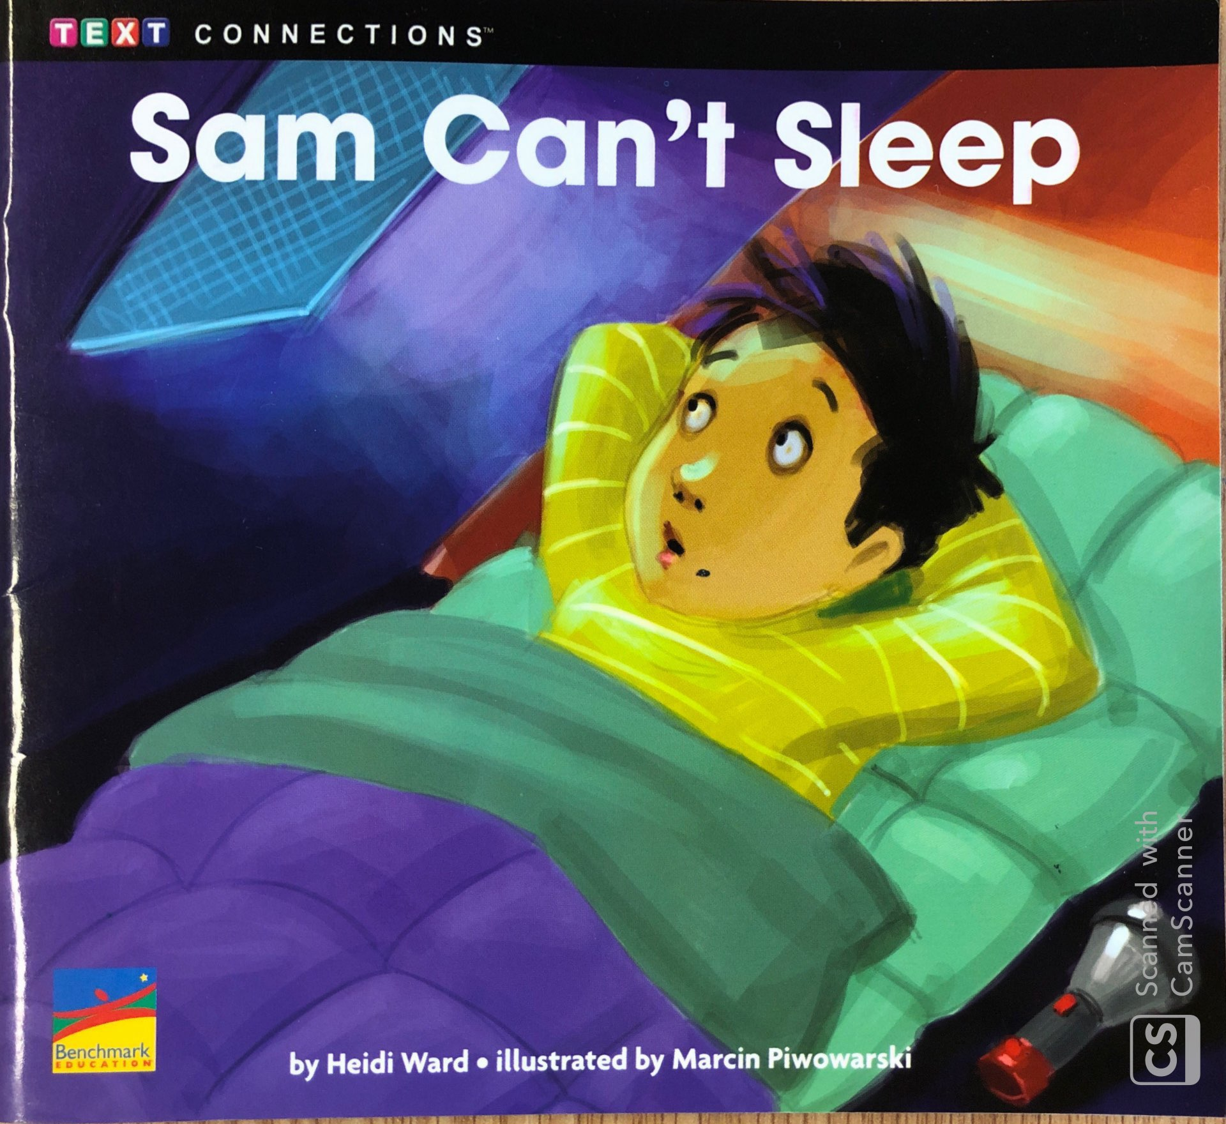
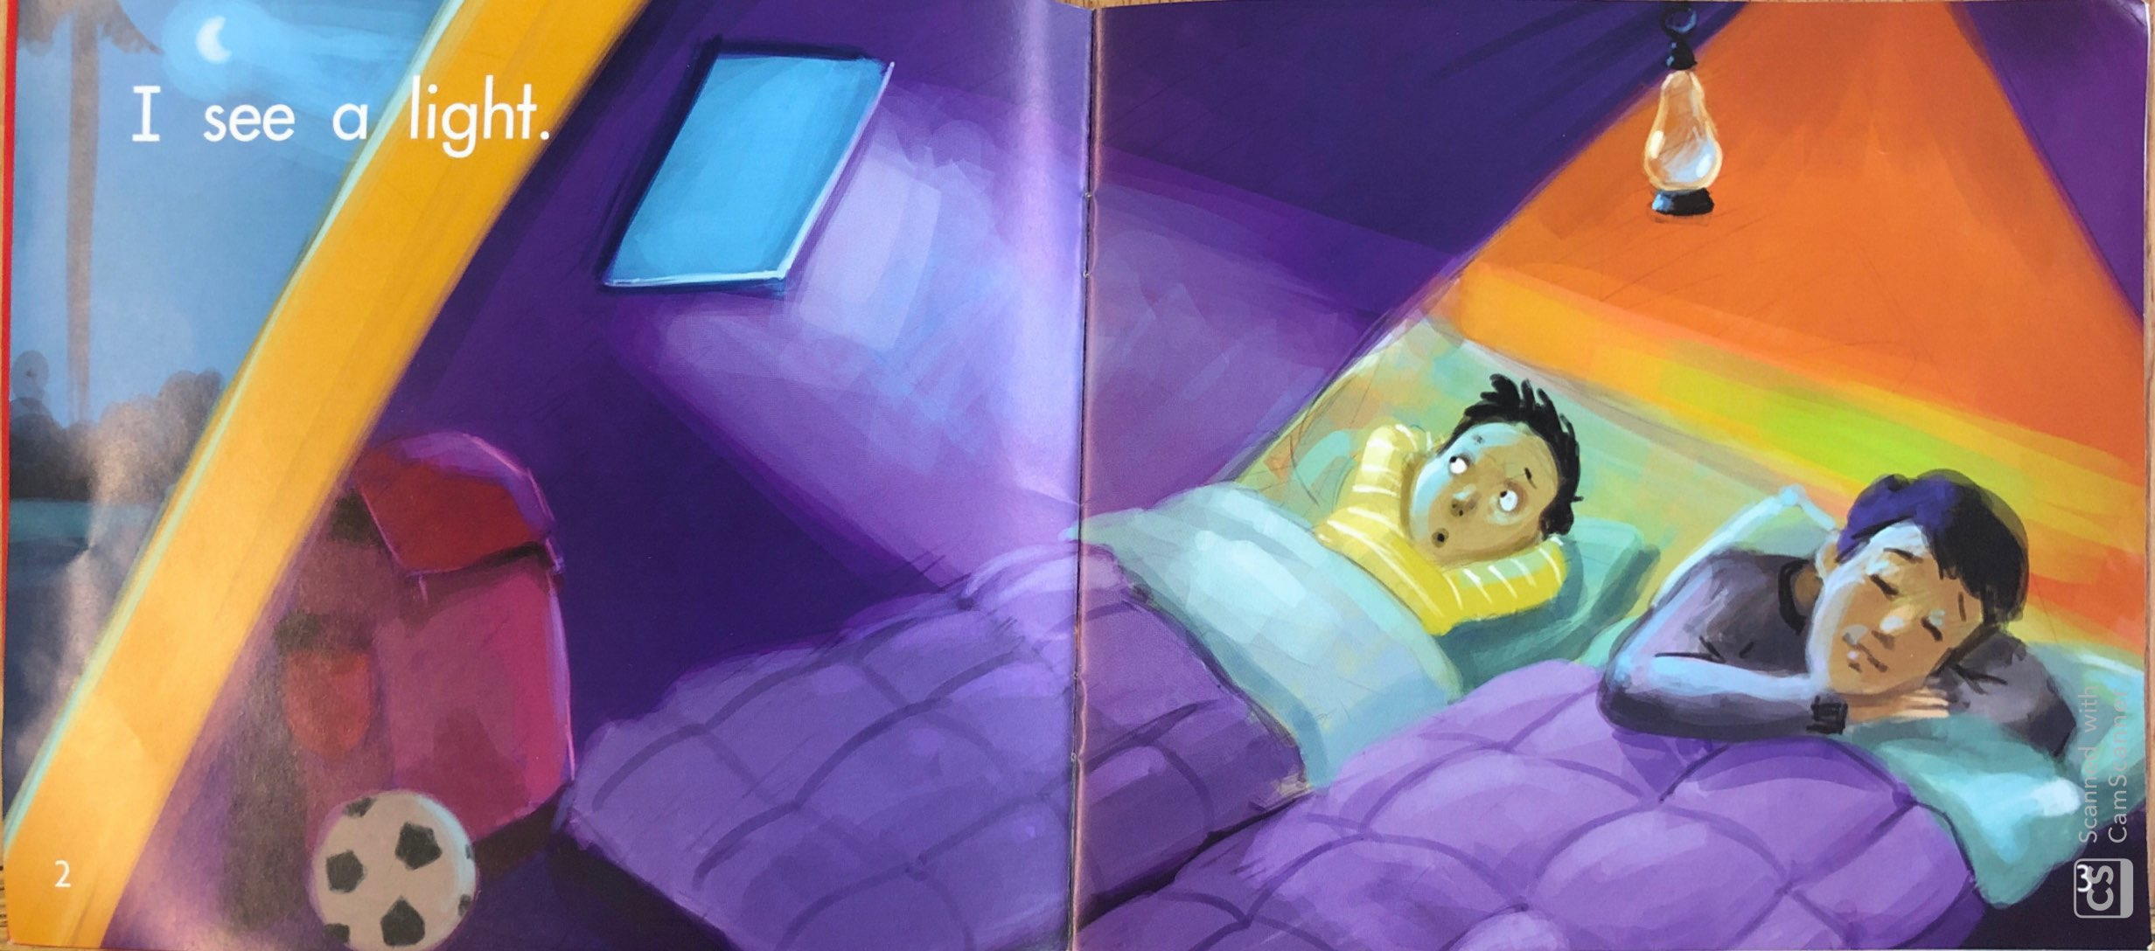
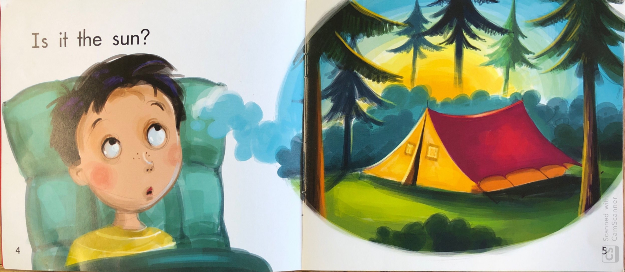
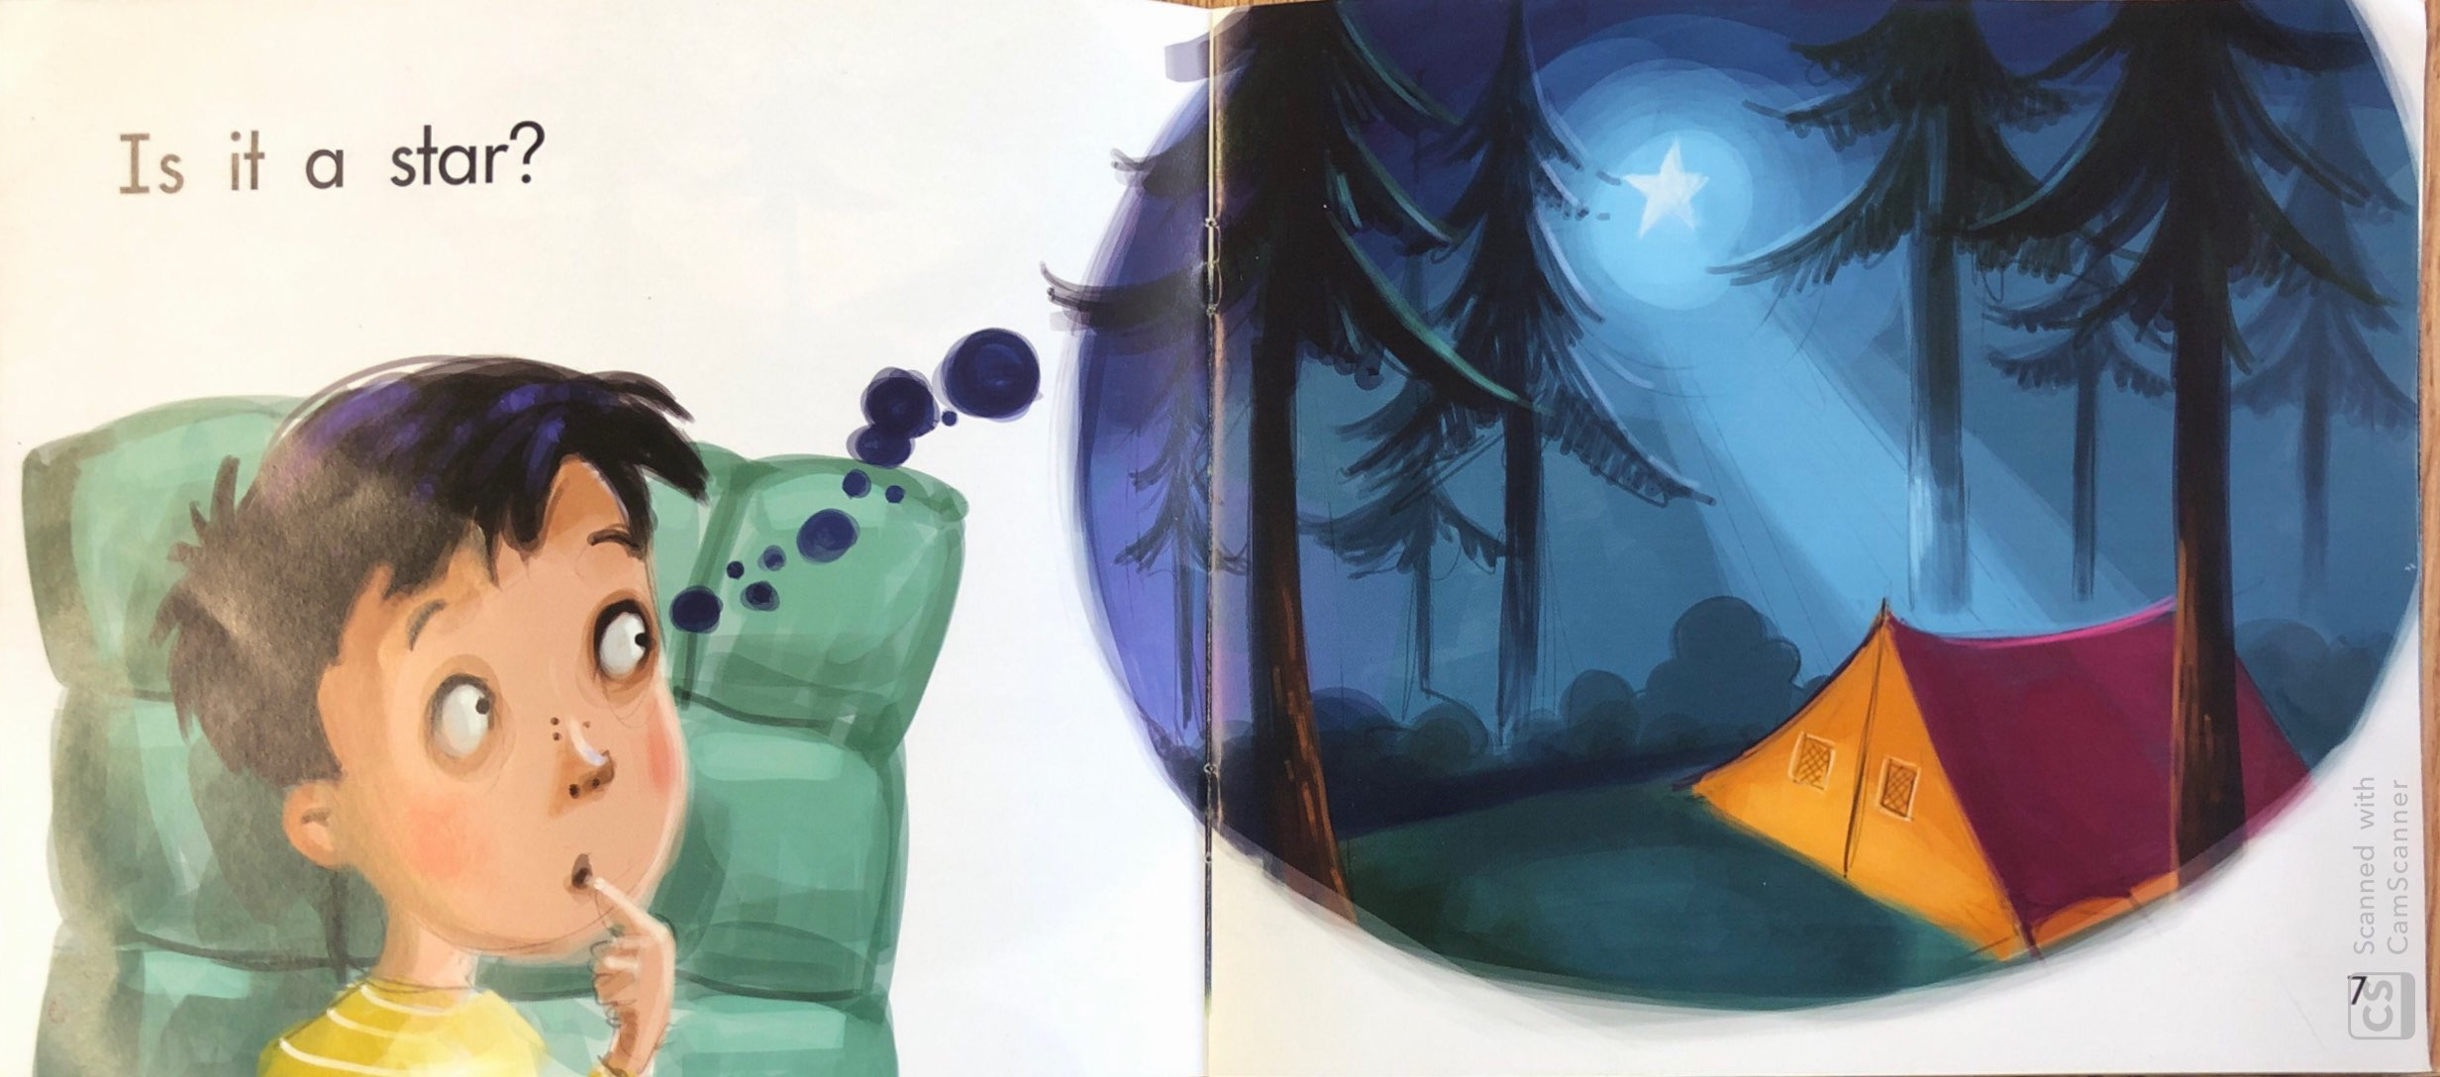
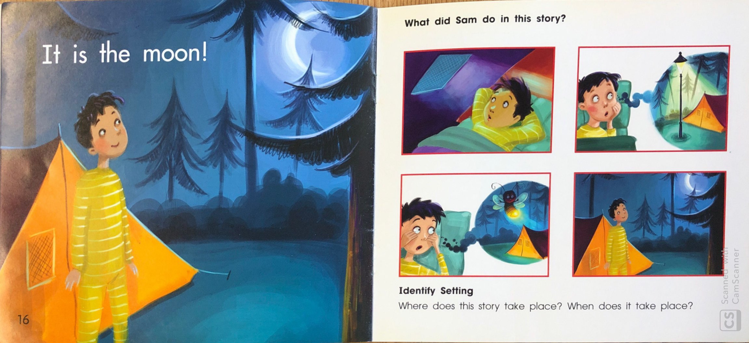
In “C” books, children start using the sounds of letters to figure out “tricky words.”
Example:
I see a light.
Is it the sun?
Is it a star?
It is the moon!

Slide 8
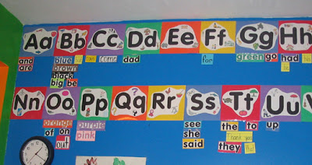
Students start to identify “sight words” without sounding it out.

Slide 9
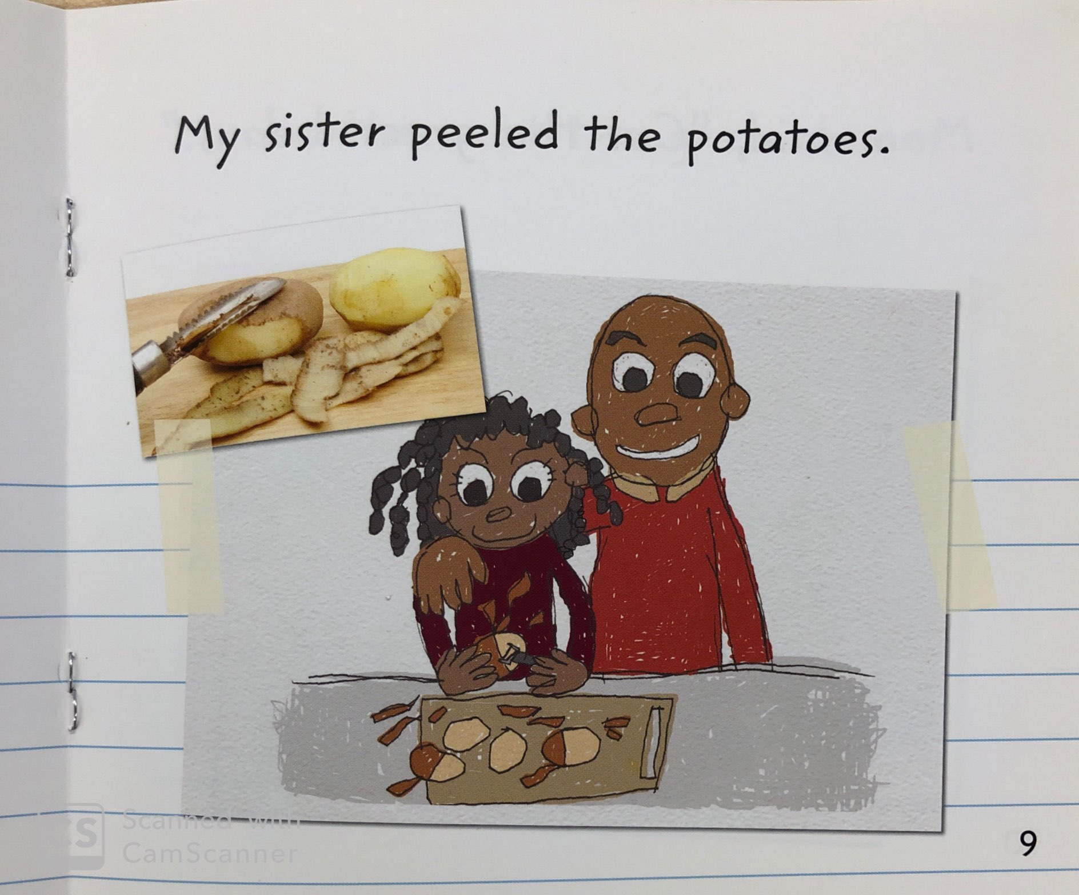
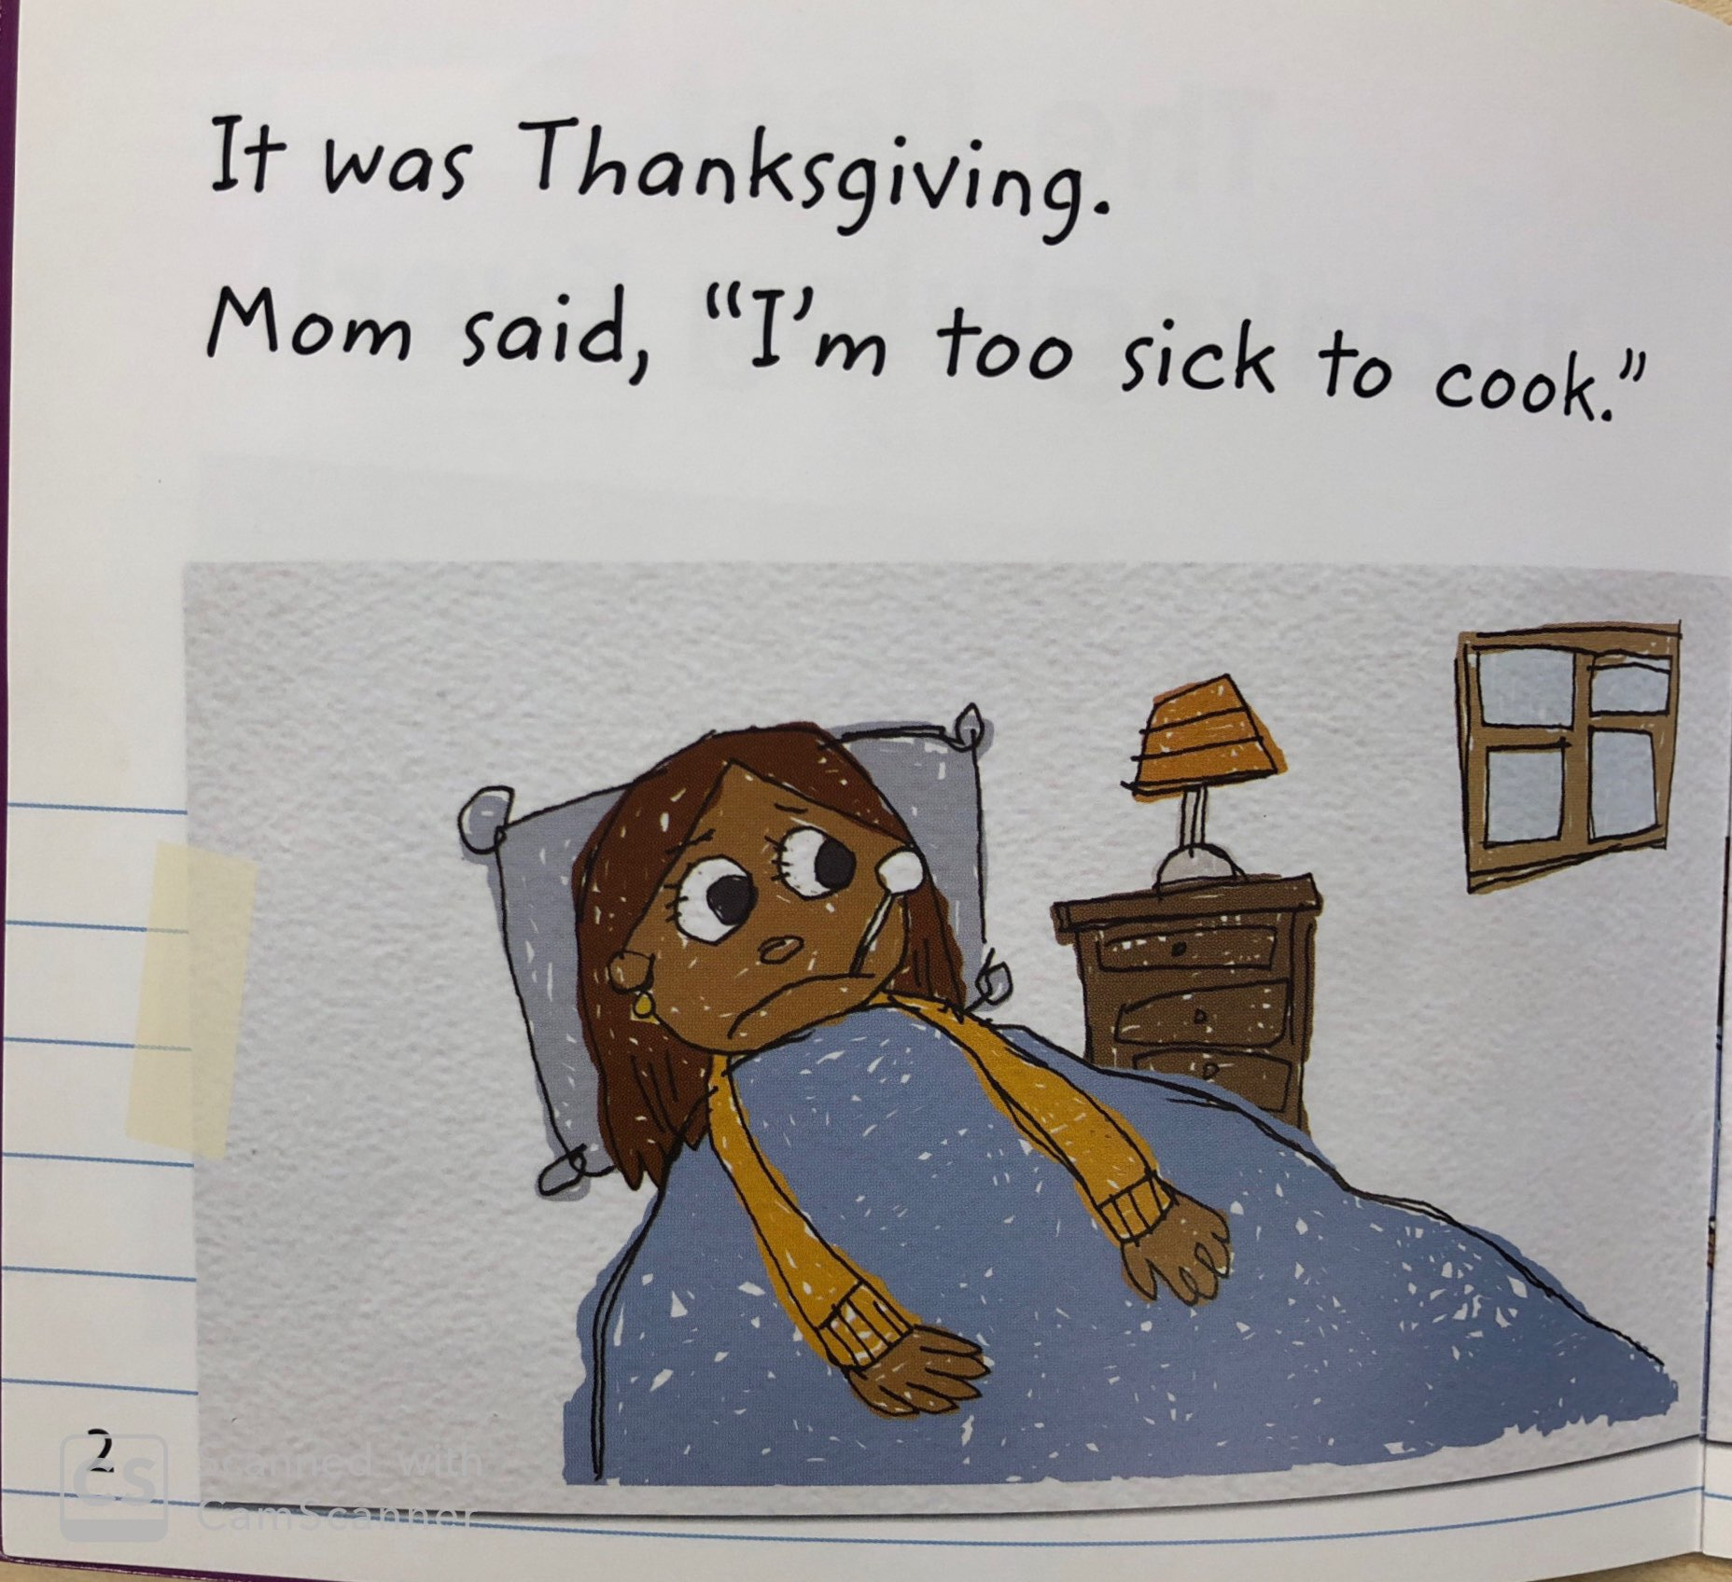
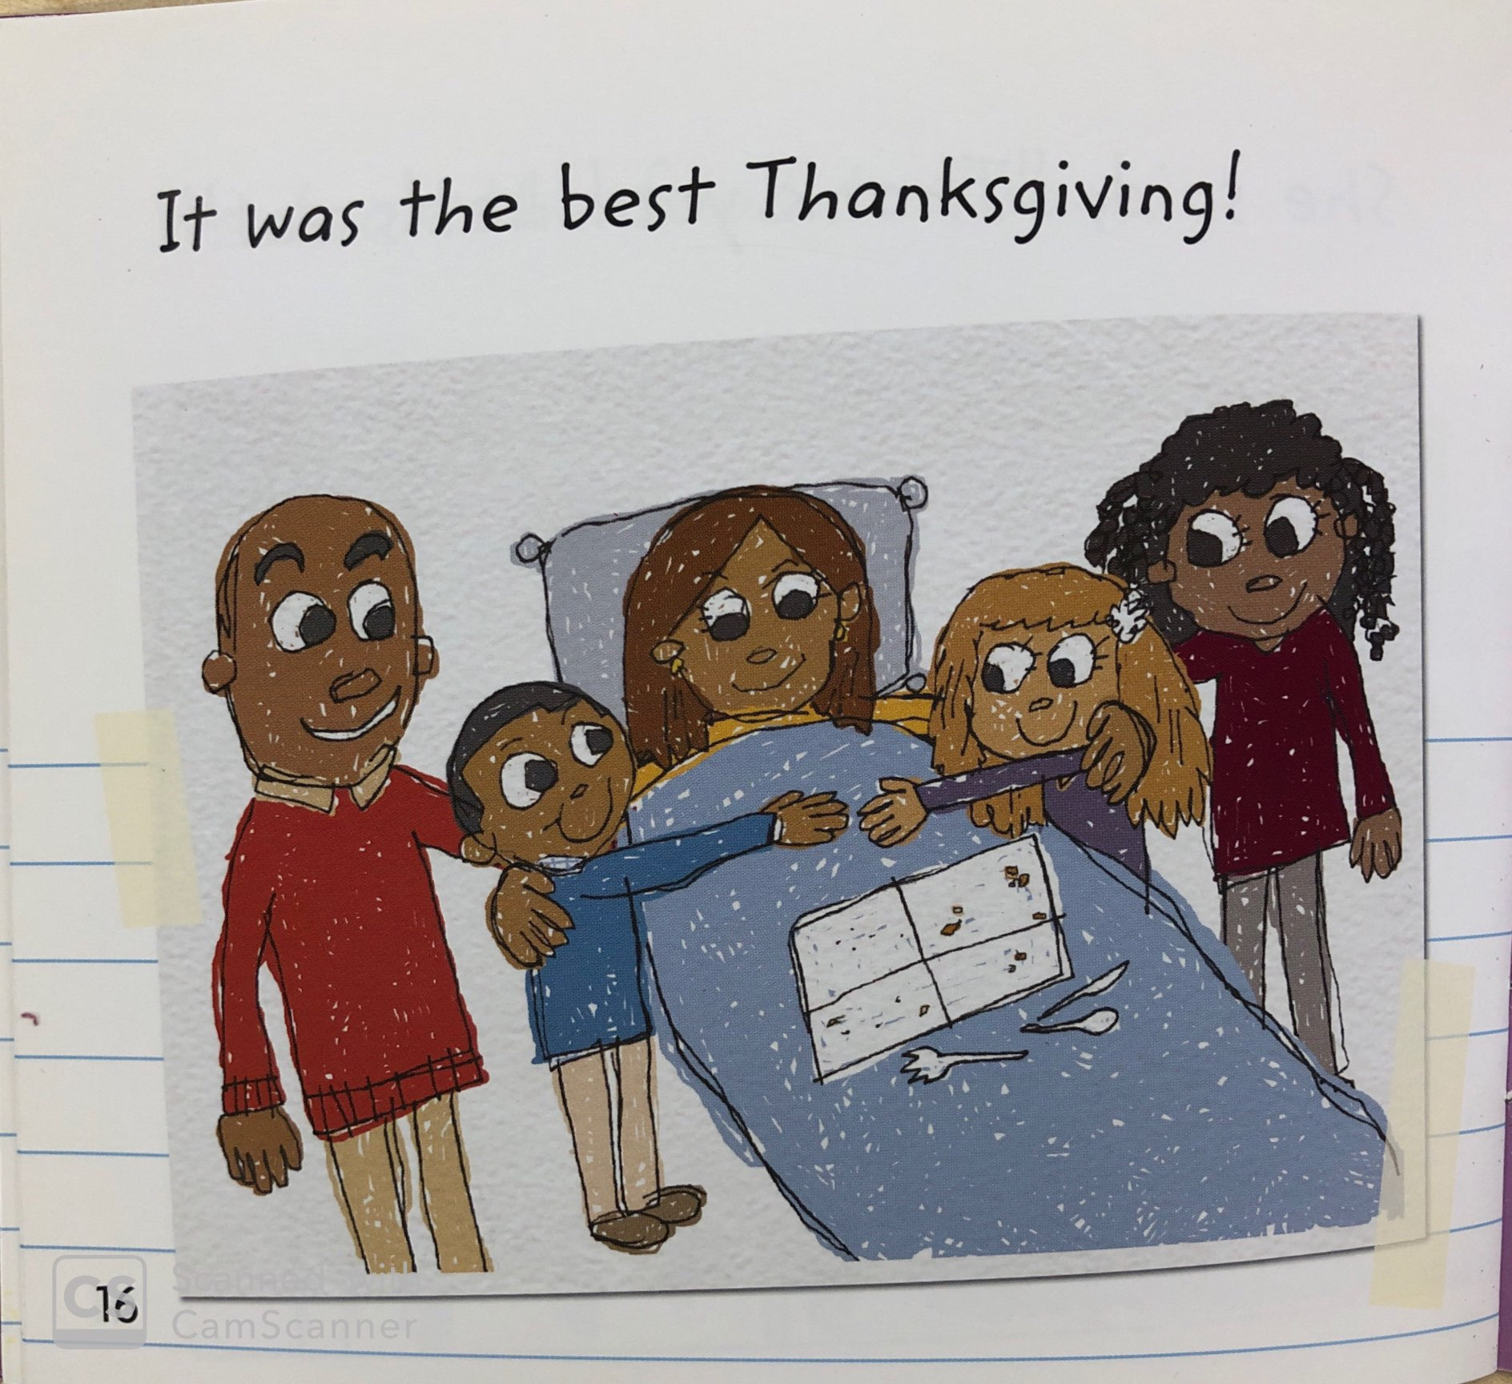
In “D” books, children begin to identify the story elements. For example: characters, setting, beginning, middle, and end.

Slide 10
“D” books may contain dialogue between characters and elicit different feelings. There is less visual support for decoding.

Slide 11
What level is my child?
Children are assessed (tested) to determine what level is “just right.”
This includes
reading the words correctly
and
demonstrating comprehension

Slide 12
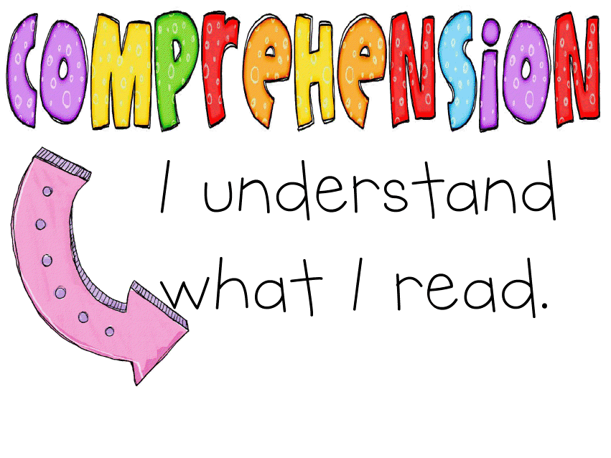
Children need to be able to answer some comprehension questions and retell key details of the story in order to move to the next reading level.

Slide 13
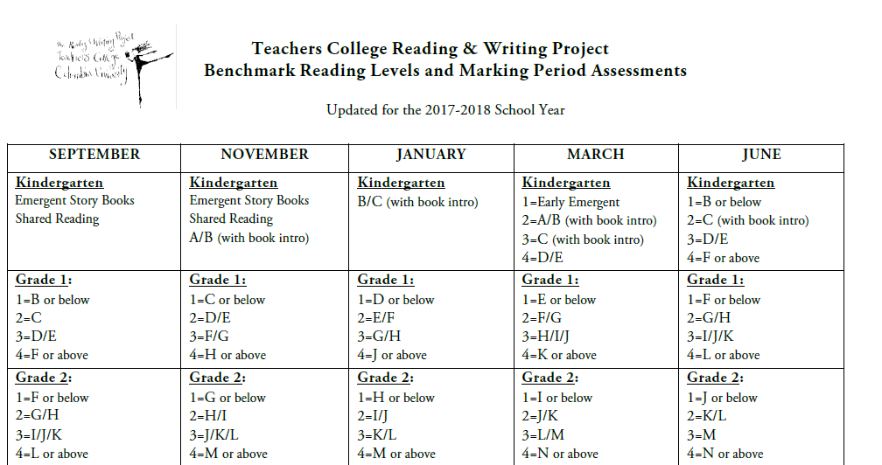
What level meets the standards?

Slide 14
THANK YOU FOR COMING!
We hope that hearing
about how we use these books
has helped you
so you can help your child
become a stronger reader!

